Slide 1
Lecture 07 – CNN Applications and Tricks
Prof. André Gustavo Hochuli
gustavo.hochuli@pucpr.br
aghochuli@ppgia.pucpr.br
Notes:
Prof. André Hochuli

Slide 2
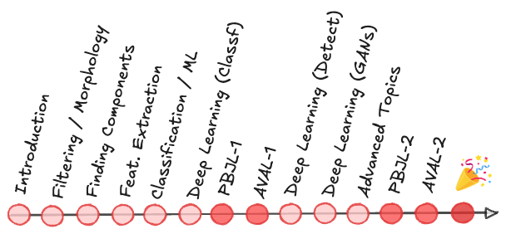
Topics
Convolutional Neural Network
Basic Concepts
Archicteture and Hiper Parameters
Data Augmentation
Transfer-Learning
Applications
Practice
Computer Vision - Prof. André Hochuli
Lecture 07
Notes:
Prof. André Hochuli

Slide 3
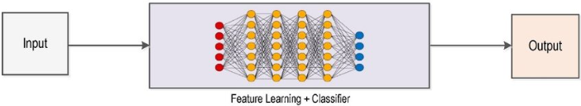
Deep Learning Pipeline
Computer Vision - Prof. André Hochuli
Lecture 10
Notes:
Prof. André Hochuli

Slide 4
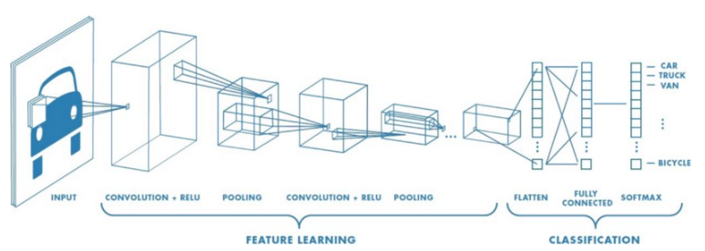
Convolutional Neural Network
CNN
Computer Vision - Prof. André Hochuli
Lecture 10
Notes:
Prof. André Hochuli

Slide 5
Convolutional Neural Network
Feature Extraction
Computer Vision - Prof. André Hochuli
Lecture 10
Notes:
Prof. André Hochuli

Slide 6
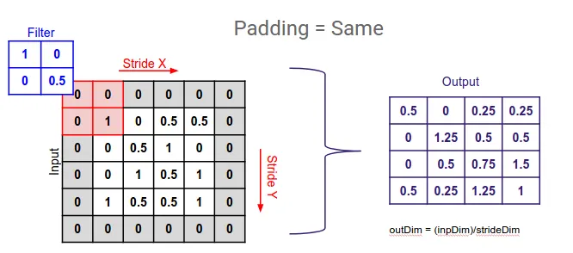
Convolutional Neural Network
Convolutional Layer (Learnable Filters)
Padding
Stride
Kernel Size
Number of Filters
Computer Vision - Prof. André Hochuli
Lecture 10
Notes:
Prof. André Hochuli

Slide 7
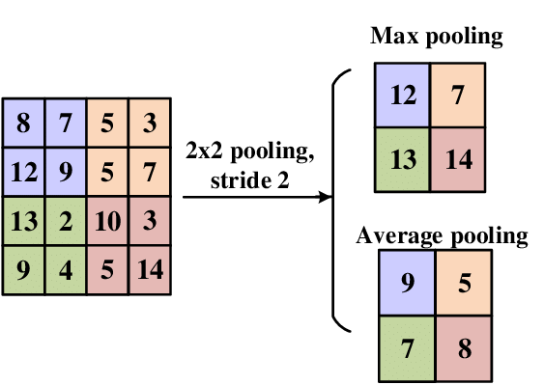
Convolutional Neural Network
Pooling Layer
Reduce Spatial Dimensions
Translation-Invariant
Common Filter
Max: Preserve the “strongest” features
Average: Smooth features, preserves general representations
Computer Vision - Prof. André Hochuli
Lecture 10
Notes:
Prof. André Hochuli

Slide 8
Convolutional Neural Network
Classification
Forward and Back Propagation
Computer Vision - Prof. André Hochuli
Lecture 10
Notes:
Prof. André Hochuli

Slide 9
Convolutional Neural Network
Forward and Back Propagation
Computer Vision - Prof. André Hochuli
Lecture 10
Notes:
Prof. André Hochuli

Slide 10
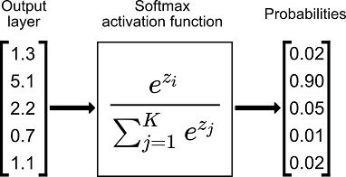
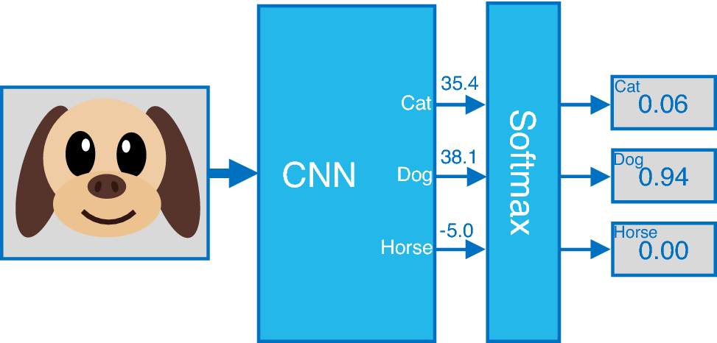
Convolutional Neural Network
Softmax
Computer Vision - Prof. André Hochuli
Lecture 10
Notes:
Prof. André Hochuli

Slide 11
Convolutional Neural Network
Lets code our first CNN from scratch
Lecture 07 - CNN Architecture
Computer Vision - Prof. André Hochuli
Lecture 10
Notes:
Prof. André Hochuli

Slide 12
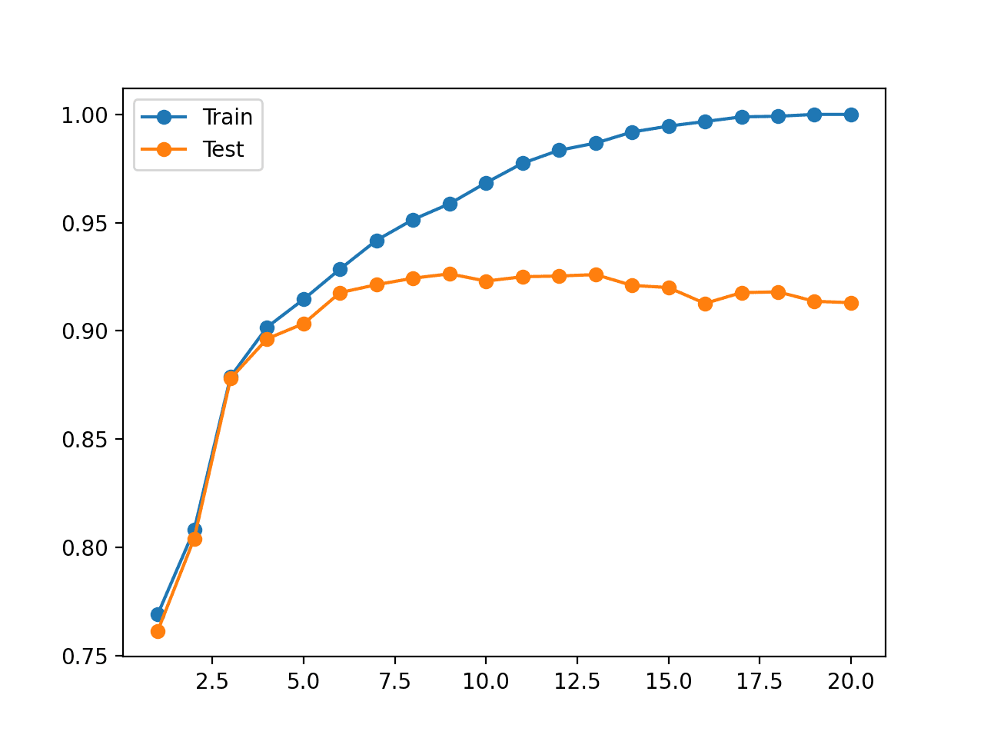
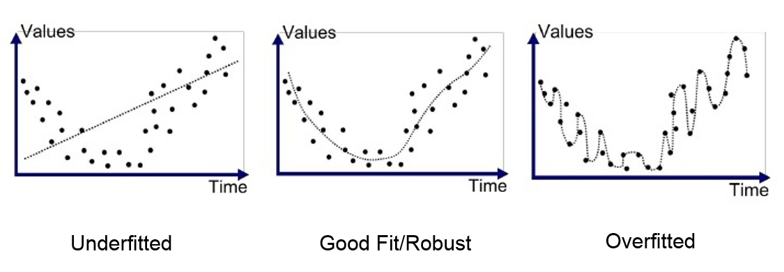
Overfitting
Overfitting occurs when a model captures noise or specific patterns in the training data, impairing its ability to generalize to unseen data. Strategies such as regularization, dropout, data augmentation, and transfer learning help mitigate this by controlling model complexity and leveraging pre-learned features.
Computer Vision - Prof. André Hochuli
Lecture 10
Notes:
Prof. André Hochuli

Slide 13
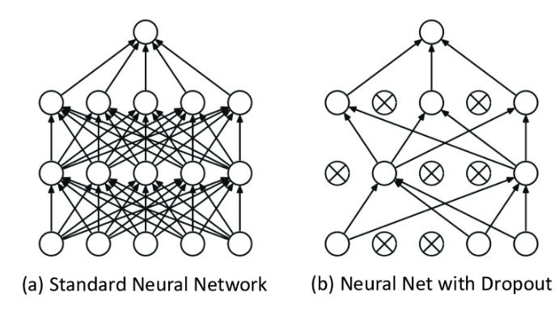
Dropout
Dropout is a regularization technique that randomly deactivates a fraction of neurons during training, forcing the model to learn redundant representations and reducing overfitting.
Computer Vision - Prof. André Hochuli
Lecture 10
Notes:
Prof. André Hochuli

Slide 14
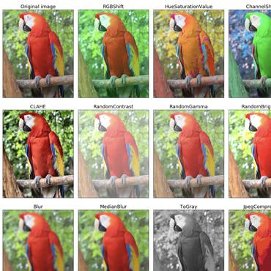
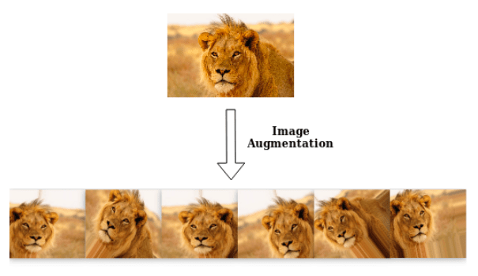
Data Augmentation
Enlarge the dataset with synthetic samples
Rotation
Crop
Brightness
Computer Vision - Prof. André Hochuli
Lecture 10
Notes:
Prof. André Hochuli

Slide 15
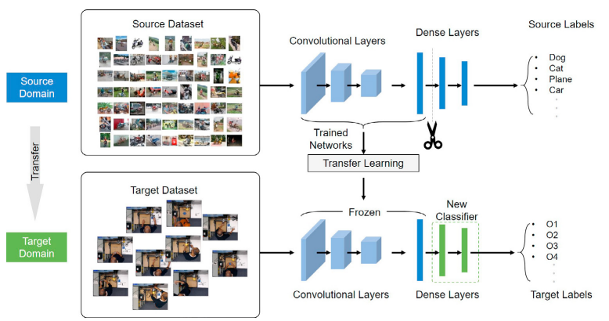
Transfer Learning
Weight Sharing
Feature Extraction weights are frozen (or not...) during learning
Computer Vision - Prof. André Hochuli
Lecture 10
Notes:
Prof. André Hochuli

Slide 16
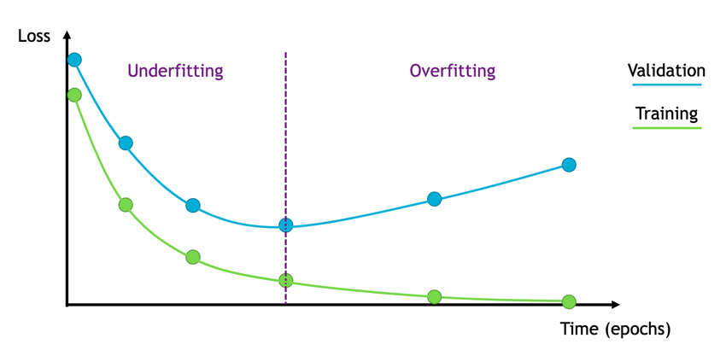
Miscellaneous
Save and Load Weights
Model Checkpoint
Resuming Training
Early Stopping
Computer Vision - Prof. André Hochuli
Lecture 10
Notes:
Prof. André Hochuli

Slide 17
Let’s Code
Lecture 07 - CNN Architecture
Computer Vision - Prof. André Hochuli
Lecture 10
Notes:
Prof. André Hochuli

